Slide 1
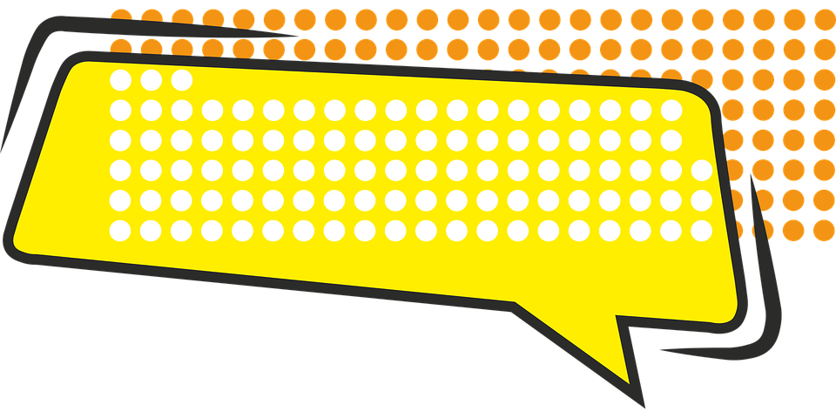
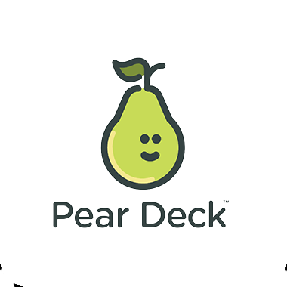
Poetic Devices
Alliteration, cONSONANCE, AND aSSONANCE
Aguirre

Slide 2
Poetic Devices
Poems are created out of poetic devices that combine structural, grammatical, rhythmic, metrical, verbal, and visual elements. They create rhythm, enhance a poem's meaning, or intensify a mood or feeling.
literarydevices.net

Slide 3
Alliteration
The repetition in two or more nearby words of initial consonant sounds.
“Peter Piper picked a peck of pickled peppers.”
literarydevices.net

Slide 4
Alliteration
Metrical patterns create rhythm and melody in a poem. When sounds are similar, they seem soothing to the ears. Poets typically use alliteration to create lines that are melodious, flowery, interesting, and musical.
literarydevices.net

Slide 5
Alliteration
Alliterative words are also typically linked purposefully and thematically.
literarydevices.net

Slide 6
Alliteration
Questions to ask yourself:
Which words are linked with alliteration? How do those words suggest a theme?
If there is a shift to or away from the use of alliteration, what does that shift suggest?
literarydevices.net

Slide 7
Consonance
The repetition of consonant sounds in successive words (whether these sounds occur at the beginning, middle, or end of words).
literarydevices.net

Slide 8
Consonance
Consonance is considered a subcategory of alliteration.
However, alliteration refers only to the repetition of consonant sounds at the beginning of words, while consonance can occur at the beginning, middle, or end of words.
literarydevices.net

Slide 9
Consonance
“I have seen them riding seaward on the waves /
Combing the white hair of the waves blown back /
When the wind blows the water white and black.”
literarydevices.net

Slide 10
Consonance
Can serve the same purpose as alliteration
Can force the reader to slow down or pause
literarydevices.net

Slide 11
Consonance
Questions to ask yourself:
Which words are linked with consonance? How do those words suggest a theme?
If there is a shift to or away from the use of consonance, what does that shift suggest?
Does the use of consonance make the poem flow, or does it force the reader to slow down? If it forces the reader to slow down, what words are emphasized or linked?
literarydevices.net

Slide 12
Assonance
Assonance refers to the repetition of vowel sounds, whether at the beginning, middle, or end, of words in close proximity to each other in a line of text.
literarydevices.net

Slide 13
Assonance
“[H]e fell asleep under the cherry tree.”
literarydevices.net

Slide 14
Assonance
Vowel sounds, in particular, set the tone and enhance mood.
literarydevices.net

Slide 15
Assonance
Questions to ask yourself:
Which words are linked with assonance? How do those words suggest a theme?
If there is a shift to or away from the use of assonance, what does that shift suggest?
literarydevices.net

Slide 16
Overlap in EFFECT of Poetic Devices
Alliteration, consonance, and assonance all create emphasis, draw attention, and underline significance.
literarydevices.net

Slide 17
Question to ask yourself about sounds (in general)
Is the sound sharp or mellow, soft or harsh?
What feelings or images do the sounds evoke?
Does the sound/poetic device persist throughout the poem, or only in certain lines? Why?
Does the sound evoke a sense of time? Of place?
literarydevices.net

Slide 18


